Slide 1
Journal
1st part

Slide 2
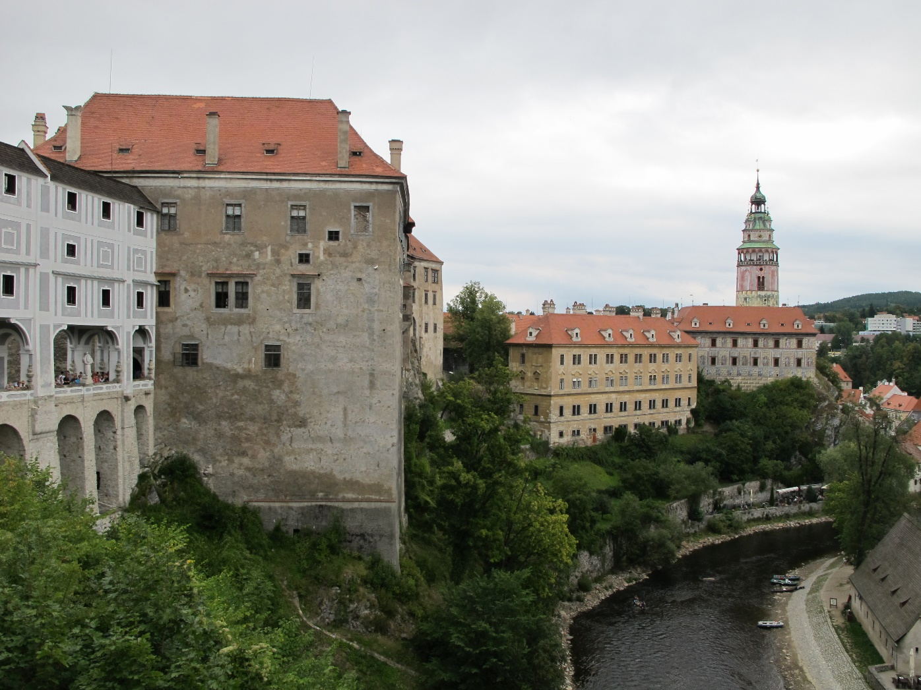
The Castle of Český Krumlov

Slide 3
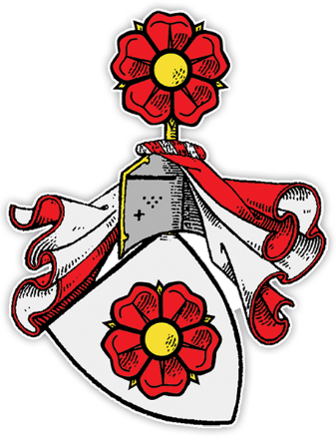
History
It was founded in the 13th century by the lords of Krumlov.
In the year of 1302 the lords of Krumlov passed away and the castle was passed to the lords of Rosenberg
The most significant person was Oldřich II. of Rosenberg (1403 -1462) he significantly extended the region of his influence
16th century – the castle was rebuilt in renessaince style.

Slide 4
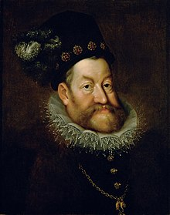
1602/1603 Petr Vok of Rosenberg sold the castle to the emperror Rudolf II.
1622-1719 the castle was taken by the noble house of Eggenbergs
1719-1947 it beloned to the house of Schwarzenbergs

Slide 5
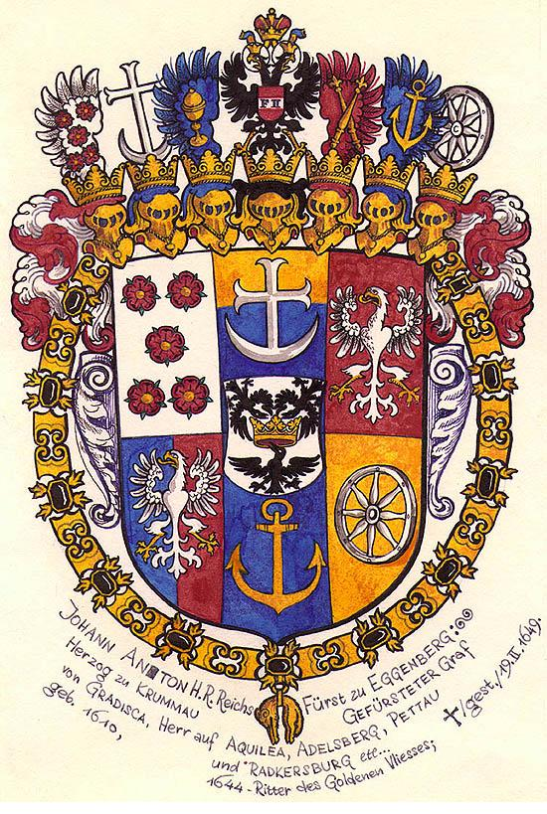
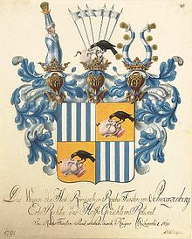
Eggenberg‘s coat of arms
Schwarzenberg‘s coat of arms

Slide 6
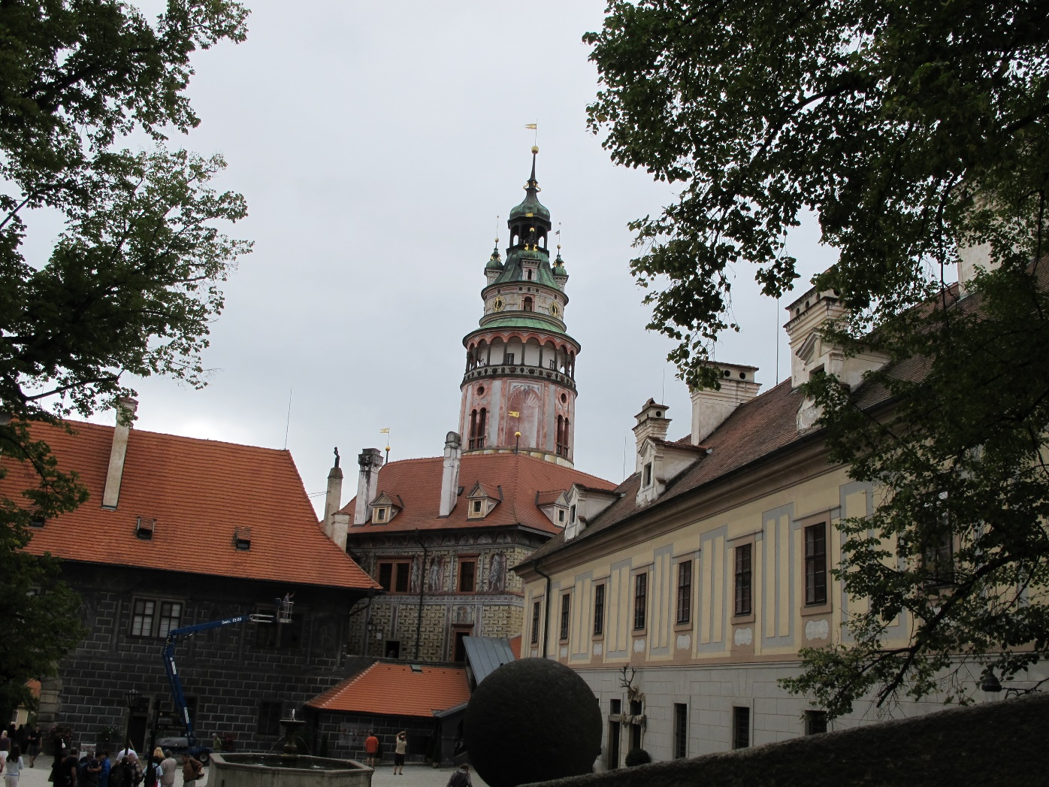
The view of the 3rd courtyard

Slide 7
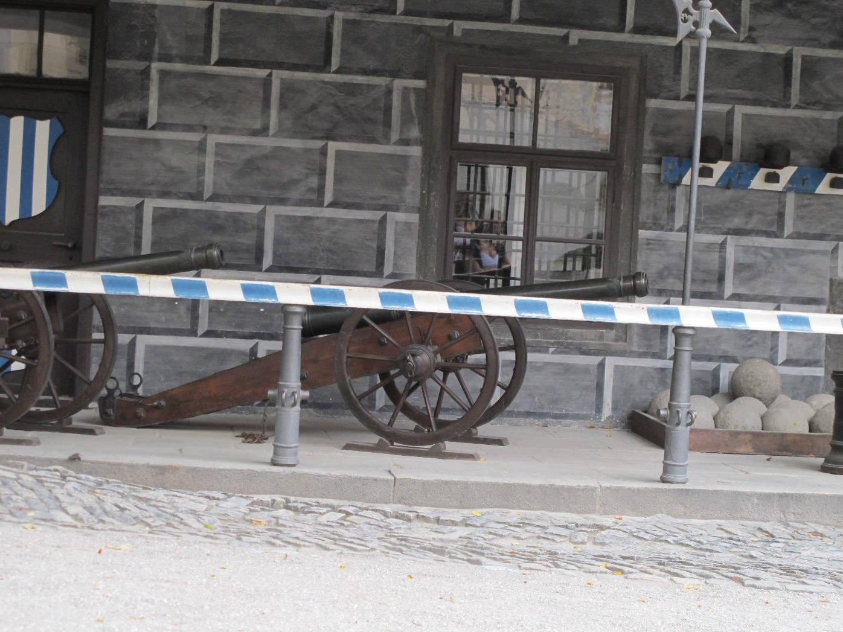
The cannons of the Schwarzenberg‘s guard

Slide 8
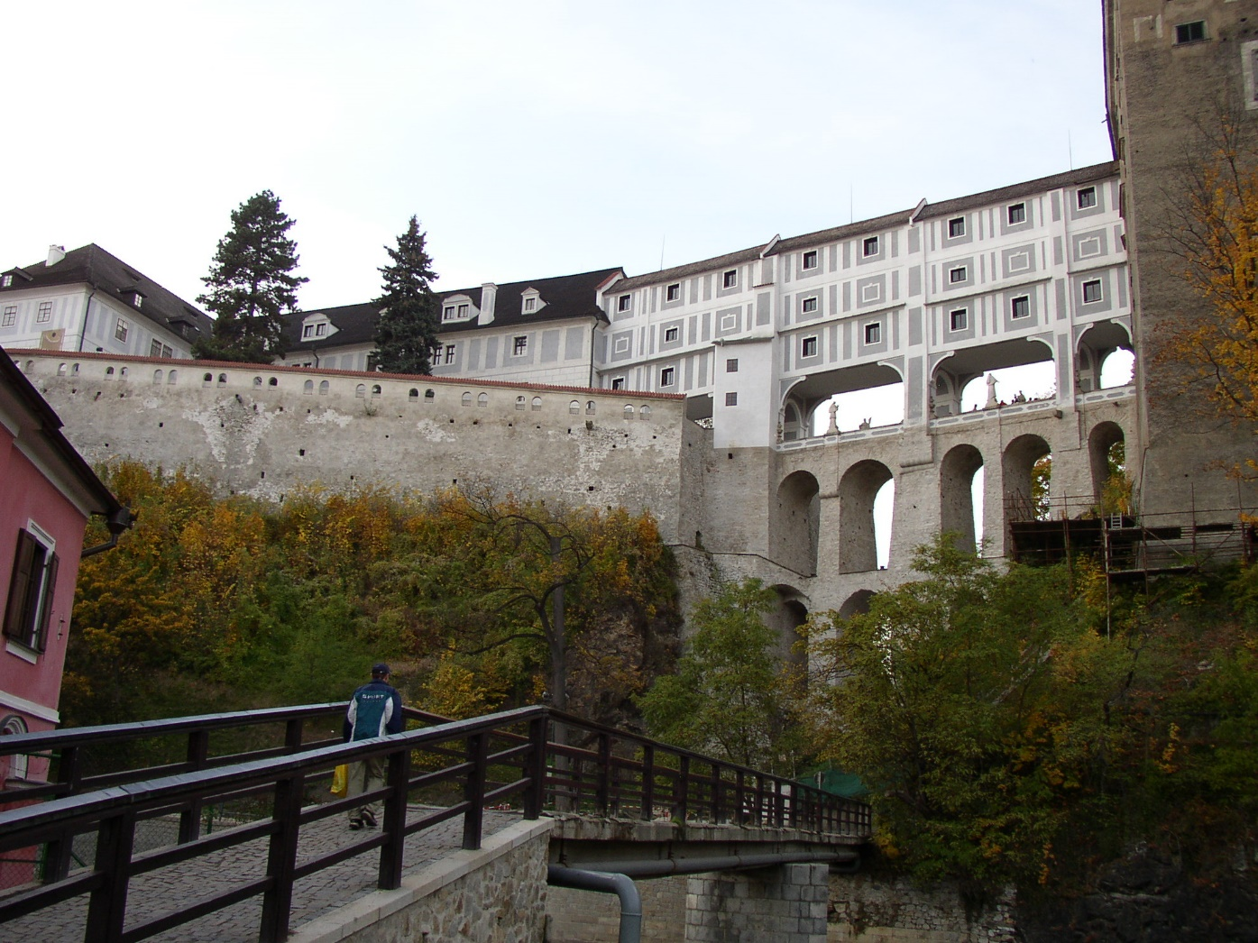
A bridge connecting the castle and the theatre

Slide 9
Image resources
https://cs.wikipedia.org/wiki/Ro%C5%BEmberkov%C3%A9
https://cs.wikipedia.org/wiki/Rudolf_II.
https://cs.wikipedia.org/wiki/Eggenbergov%C3%A9
https://cs.wikipedia.org/wiki/Schwarzenbergov%C3%A9
Photo archive of the author

